Slide 1

Image Steganography
By Ashish Gupta
Art of hiding data in plain sight!

Slide 2
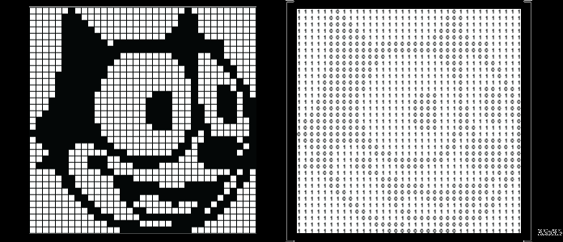
What are images?
Number matrices ( Eg. 600 * 600)
Each number → Color intensity.
2 types:
GrayScale ( 600*600*1)
Colored (600*600*3) where 3 represents each of red, green, blue

Slide 3
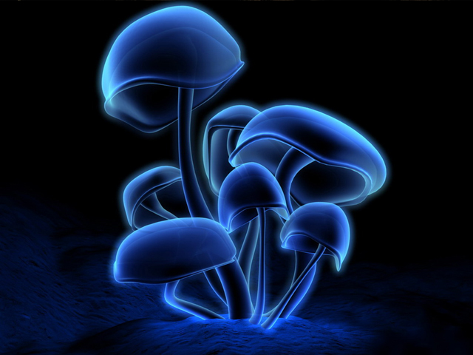

This image has no data
Harry potter and sorcerer's stone

Slide 4
But they look the same?
This is exactly why data is hidden into an image!

Slide 5
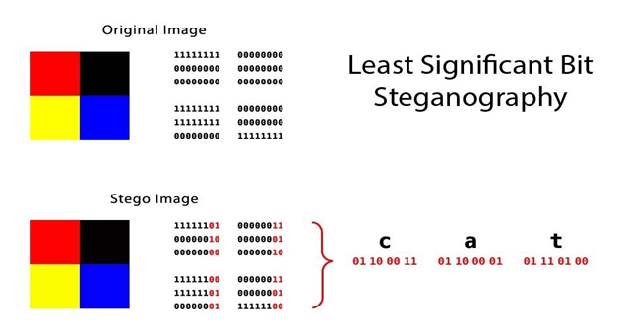
Step 1: Putting data into image
Each pixel is stored as binary
Convert message to binary (Ex CAT in the image → )
Select numbers of image one by one and convert them to binary
Take 2 bits from message at a time and store these 2 bits into last positions of image binary numbers.
Done!

Slide 6
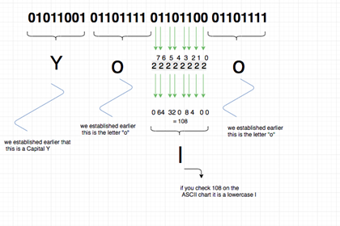
Step 2: Extracting Data
Read the image numbers one by one and convert to binary.
Take the 2 bits and append them as a string
Read the whole string as Ascii characters taking 8 bits at a time.
Ex(11000011100001→ AA(1100001 + 1100001))

Slide 7
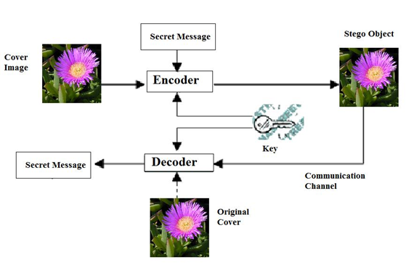
Whole Process

Slide 8
Let’s get into live action!
We will encrypt entire text of Harry Potter - Part 1 in a mushroom’s image!

Slide 9
Conclusion
Thus data can be hidden in plain sight from the unauthorised user and can be delivered anywhere across the globe. Steganography is the way to maintain secret communication between 2 parties.
Hence applications include:
Secret medical data of celebrities.
Password database of a company.
Secret project reports, contract papers etc.
Other infinite solutions being researched!

Slide 10

Thank You!

